Slide 1
Applied Software Security
Lecture 2

Slide 2
Overview
Machine code abi implementation:
the stack, frames, arguments and variables, calling conventions.
Process overview:
file formats, loading, memory, runtime and standard library, heap.
(Possibly start) Integration in the operating system:
OS apis: system calls, files, permissions.

Slide 3
Machine code abi imlementation
Separating code into functional modules:
We want a mechanism that enables our code to use other code, without knowing how the other code is implemented, and without the other code knowing how our code is implemented
I.e: Andrey wrote very sophisticated code which prints numbers as strings on the screen. Alon wants to write code that iteratively prints the elements of some sequence a(n) on the screen. Alon is lazy and really does not care how you actually do the printing to the screen. Andrey does not care who uses his code.
In practice, Alon is actually very lazy.

Slide 4
Functions, Calling conventions and the stack
Calling convention: A contract / set of rules, that logical code units adhere to, that ensures interoperability between the units.
It enables one unit to use another as a black box, and allows abstraction of the functionality, hiding the internal mechanism of each unit.
Often code units implement this using designated machine instructions (call, ret, push, pop) and mechanisms (the stack and stack frames implementations using the registers rsp and rbp). Such code unints are often referred to as functions.

Slide 5
The stack
As we have previously seen, an x86-64 machine has special registers named rsp (and rbp), and instructions push and pop, that operate in the following way:
push x: pop y:
sub rsp, size_of(x) mov size_of(y) y, [rsp]
mov size_of(x) [rsp], x add rsp, size_of(y)
where x and y are some operands, usually registers or memory operands (qword [rax], word [0x49] ….).
Note note all operand / operand sizes are allowed: It is illegal to push and pop 4/1 byte operands in 64 bit (8/2 are allowed).
rsp along with the push and pop instructions enable implementing a stack data structure.
Note that the stack grows downward with with memory adderss (i.e. after push, rsp is smaller, and after pop is greater). Why?

Slide 6
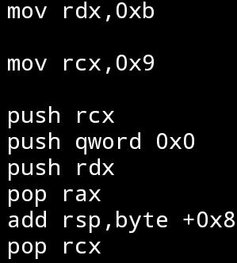
Example
addr
content
rsp = 0x1018
1000
????
rax = ?
1008
????
rdx = ?
1010
????
rcx = ?
1018
????
1020
????
????
????

Slide 7
addr
content
rsp = 0x1018
1000
????
rax = ?
1008
????
rdx = 0x0b
1010
????
rcx = ?
1018
????
1020
????
????
????

Slide 8
addr
content
rsp = 0x1018
1000
????
rax = ?
1008
????
rdx = 0x0b
1010
????
rcx = 0x09
1018
????
1020
????
????
????

Slide 9
addr
content
rsp = 0x1010
1000
????
rax = ?
1008
????
rdx = 0x0b
1010
0x09
rcx = 0x09
1018
????
1020
????
????
????

Slide 10
addr
content
rsp = 0x1008
1000
????
rax = ?
1008
0x00
rdx = 0x0b
1010
0x09
rcx = 0x09
1018
????
1020
????
????
????

Slide 11
addr
content
rsp = 0x1000
1000
0x0b
rax = ?
1008
0x00
rdx = 0x0b
1010
0x09
rcx = 0x09
1018
????
1020
????
????
????

Slide 12
addr
content
rsp = 0x1008
1000
0x0b
rax = 0x0b
1008
0x00
rdx = 0x0b
1010
0x09
rcx = 0x09
1018
????
1020
????
????
????

Slide 13
addr
content
rsp = 0x1010
1000
0x0b
rax = 0x0b
1008
0x00
rdx = 0x0b
1010
0x09
rcx = 0x09
1018
????
1020
????
????
????

Slide 14
addr
content
rsp = 0x1018
1000
0x0b
rax = 0x0b
1008
0x00
rdx = 0x0b
1010
0x09
rcx = 0x09
1018
????
1020
????
????
????

Slide 15
Calling a function
The call and ret instructions preform the following*:
call x: ret y:
push rip pop rip
jmp x
They enable trasfering control to an arbitrary piece of code at address x, and transfering to it the address of the code it should return to when it is finished.
Note that the value of rip pushed is the address of the instruction after the call instruction (this is due to the fact that when the call instruction is executed, rip has already been incremented to point to the next (unfetched) instruction), we will (possibly) talk more about this later in the course.
* pushing and popping rip cannot be done directly.

Slide 16
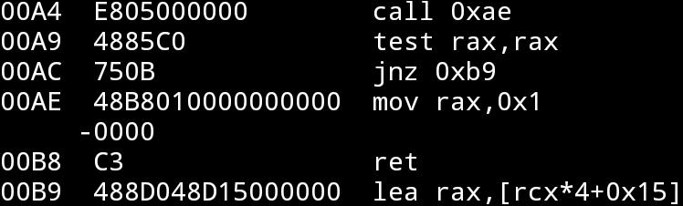
Example
rip = 0xa4
addr
content
rsp = 0x1018
1000
????
rax = ?
1008
????
rdx = ?
1010
????
rcx = ?
1018
????
1020
????
????
????

Slide 17
Example
rip = 0xae
addr
content
rsp = 0x1010
1000
????
rax = ?
1008
????
rdx = ?
1010
0xa9
rcx = ?
1018
????
1020
????
????
????

Slide 18
Example
rip = 0xb8
addr
content
rsp = 0x1010
1000
????
rax = 0x01
1008
????
rdx = ?
1010
0xa9
rcx = ?
1018
????
1020
????
????
????

Slide 19
Example
rip = 0xa9
addr
content
rsp = 0x1018
1000
????
rax = 0x01
1008
????
rdx = ?
1010
0xa9
rcx = ?
1018
????
1020
????
????
????

Slide 20
Example
rip = 0xac
addr
content
rsp = 0x1018
1000
????
rax = 0x01
1008
????
rdx = ?
1010
0xa9
rcx = ?
1018
????
1020
????
????
????

Slide 21
Example
rip = 0xb9
addr
content
rsp = 0x1018
1000
????
rax = 0x01
1008
????
rdx = ?
1010
0xa9
rcx = ?
1018
????
1020
????
????
????

Slide 22
Several basic problems arise:
We may want to be able pass arguments to a function we call, and get a return value from it.
The function we call runs using the same resources as us, namely memory and registers, and might want to actually change their value. We on the other hand would like to continue our execution as we were before the function call.
This is solved using stack frames and an agreed upon calling convention

Slide 23
Stack frames
Often used to create and maintain the local context of a function, and to restore the context to the context of the caller, when the function returns.
Implemented using the stack structure maintained by rsp, and the register rbp (the “stack base pointer”):
rsp will always point to the top of the stack, which can be pushed to and popped from thus implementing a stack (lifo) structure.
rbp will be used to maintain each function’s “working space” on the stack, when called, a function will save the caller’s stack base pointer before using rbp, and restore it upon returning.

Slide 24
In details:
At the beggining of the function, the function will save the pointer to the base of the callers stack frame by pushing rbp to the top of the stack, then save the address of this pushed rbp in rbp. Upon returning, it will restore rbp by popping from rbp to rbp, as follows:
func_code:
push rbp
mov rbp, rsp
func does whatever func likes, as long as it maintains rbp and
does not overwrite the previous functions’ stack frames.
Any function called from func is assumed to, when returning to
func, restore it’s rbp (and rsp).
mov rsp, rbp
pop rbp
ret

Slide 25
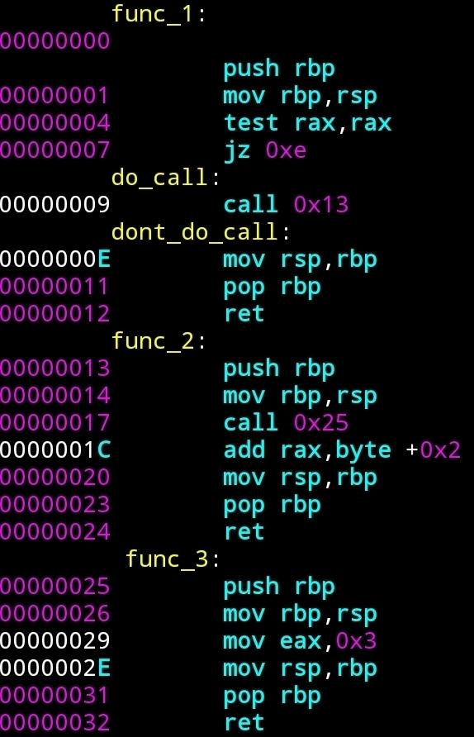
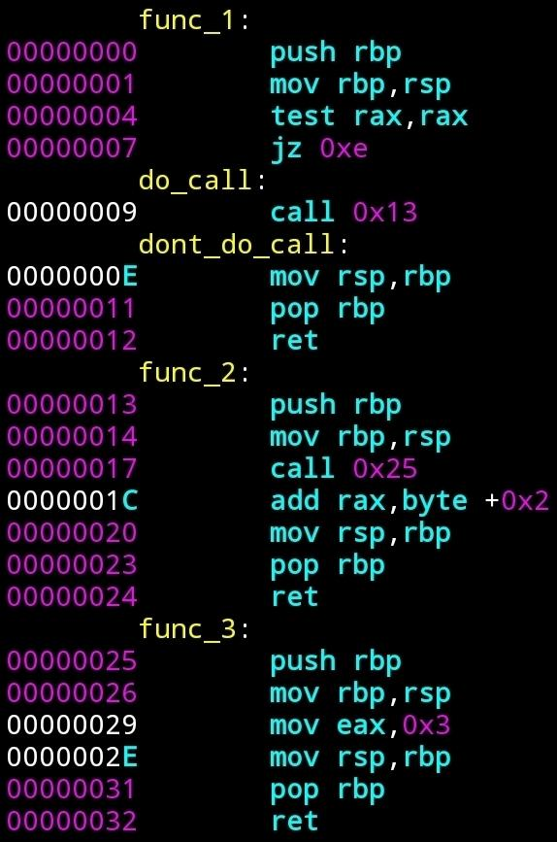
addr
content
1000
????
rip = 0x0
1008
????
rsp = 0x1050
1010
????
rbp = v
1018
????
rax = 0x2022
1020
????
1028
????
1030
????
1038
????
1040
????
1048
????
1050
caller_rip
1058
????

Slide 26
addr
content
1000
????
rip = 0x01
1008
????
rsp = 0x1048
1010
????
rbp = v
1018
????
rax = 0x2022
1020
????
1028
????
1030
????
1038
????
1040
????
1048
v
1050
caller_rip
1058
????

Slide 27
addr
content
1000
????
rip = 0x04
1008
????
rsp = 0x1048
1010
????
rbp = 0x1048
1018
????
rax = 0x2022
1020
????
1028
????
1030
????
1038
????
1040
????
1048
v
1050
caller_rip
1058
????

Slide 28
addr
content
1000
????
rip = 0x07
1008
????
rsp = 0x1048
1010
????
rbp = 0x1048
1018
????
rax = 0x2022
1020
????
1028
????
1030
????
1038
????
1040
????
1048
v
1050
caller_rip
1058
????

Slide 29
addr
content
1000
????
rip = 0x09
1008
????
rsp = 0x1048
1010
????
rbp = 0x1048
1018
????
rax = 0x2022
1020
????
1028
????
1030
????
1038
????
1040
????
1048
v
1050
caller_rip
1058
????

Slide 30
addr
content
1000
????
rip = 0x13
1008
????
rsp = 0x1040
1010
????
rbp = 0x1048
1018
????
rax = 0x2022
1020
????
1028
????
1030
????
1038
????
1040
0x0e
1048
v
1050
caller_rip
1058
????

Slide 31
addr
content
1000
????
rip = 0x14
1008
????
rsp = 0x1038
1010
????
rbp = 0x1048
1018
????
rax = 0x2022
1020
????
1028
????
1030
????
1038
0x1048
1040
0x0e
1048
v
1050
caller_rip
1058
????

Slide 32
addr
content
1000
????
rip = 0x17
1008
????
rsp = 0x1038
1010
????
rbp = 0x1038
1018
????
rax = 0x2022
1020
????
1028
????
1030
????
1038
0x1048
1040
0x0e
1048
v
1050
caller_rip
1058
????

Slide 33
addr
content
1000
????
rip = 0x25
1008
????
rsp = 0x1030
1010
????
rbp = 0x1038
1018
????
rax = 0x2022
1020
????
1028
????
1030
0x1c
1038
0x1048
1040
0x0e
1048
v
1050
caller_rip
1058
????

Slide 34
addr
content
1000
????
rip = 0x26
1008
????
rsp = 0x1028
1010
????
rbp = 0x1038
1018
????
rax = 0x2022
1020
????
1028
0x1038
1030
0x1c
1038
0x1048
1040
0x0e
1048
v
1050
caller_rip
1058
????

Slide 35
addr
content
1000
????
rip = 0x29
1008
????
rsp = 0x1028
1010
????
rbp = 0x1028
1018
????
rax = 0x2022
1020
????
1028
0x1038
1030
0x1c
1038
0x1048
1040
0x0e
1048
v
1050
caller_rip
1058
????

Slide 36
addr
content
1000
????
rip = 0x2e
1008
????
rsp = 0x1028
1010
????
rbp = 0x1028
1018
????
rax = 0x03
1020
????
1028
0x1038
1030
0x1c
1038
0x1048
1040
0x0e
1048
v
1050
caller_rip
1058
????

Slide 37
addr
content
1000
????
rip = 0x31
1008
????
rsp = 0x1028
1010
????
rbp = 0x1028
1018
????
rax = 0x03
1020
????
1028
0x1038
1030
0x1c
1038
0x1048
1040
0x0e
1048
v
1050
caller_rip
1058
????

Slide 38
addr
content
1000
????
rip = 0x32
1008
????
rsp = 0x1030
1010
????
rbp = 0x1038
1018
????
rax = 0x03
1020
????
1028
0x1038
1030
0x1c
1038
0x1048
1040
0x0e
1048
v
1050
caller_rip
1058
????

Slide 39
addr
content
1000
????
rip = 0x1c
1008
????
rsp = 0x1038
1010
????
rbp = 0x1038
1018
????
rax = 0x03
1020
????
1028
0x1038
1030
0x1c
1038
0x1048
1040
0x0e
1048
v
1050
caller_rip
1058
????

Slide 40
addr
content
1000
????
rip = 0x20
1008
????
rsp = 0x1038
1010
????
rbp = 0x1038
1018
????
rax = 0x05
1020
????
1028
0x1038
1030
0x1c
1038
0x1048
1040
0x0e
1048
v
1050
caller_rip
1058
????

Slide 41
addr
content
1000
????
rip = 0x23
1008
????
rsp = 0x1038
1010
????
rbp = 0x1038
1018
????
rax = 0x05
1020
????
1028
0x1038
1030
0x1c
1038
0x1048
1040
0x0e
1048
v
1050
caller_rip
1058
????

Slide 42
addr
content
1000
????
rip = 0x24
1008
????
rsp = 0x1040
1010
????
rbp = 0x1048
1018
????
rax = 0x05
1020
????
1028
0x1038
1030
0x1c
1038
0x1048
1040
0x0e
1048
v
1050
caller_rip
1058
????

Slide 43
addr
content
1000
????
rip = 0xe
1008
????
rsp = 0x1048
1010
????
rbp = 0x1048
1018
????
rax = 0x05
1020
????
1028
0x1038
1030
0x1c
1038
0x1048
1040
0x0e
1048
v
1050
caller_rip
1058
????

Slide 44
addr
content
1000
????
rip = 0x11
1008
????
rsp = 0x1048
1010
????
rbp = 0x1048
1018
????
rax = 0x05
1020
????
1028
0x1038
1030
0x1c
1038
0x1048
1040
0x0e
1048
v
1050
caller_rip
1058
????

Slide 45
addr
content
1000
????
rip = 0x12
1008
????
rsp = 0x1050
1010
????
rbp = v
1018
????
rax = 0x05
1020
????
1028
0x1038
1030
0x1c
1038
0x1048
1040
0x0e
1048
v
1050
caller_rip
1058
????

Slide 46
addr
content
1000
????
rip = caller_rip
1008
????
rsp = 0x1058
1010
????
rbp = v
1018
????
rax = 0x05
1020
????
1028
0x1038
1030
0x1c
1038
0x1048
1040
0x0e
1048
v
1050
caller_rip
1058
????

Slide 47
That was nice but why did we actually need all of the rbp rsp manipulating?
Sometimes it is really not needed, as in our simple examples, but:
It enabled us to create a stack frame, in which each function can freely operate.
Our previous functions didn’t really do anything.
Suppose we wanted to use arguments and local variables.
Using the stack and the function’s stack frame, we can implement this.

Slide 48
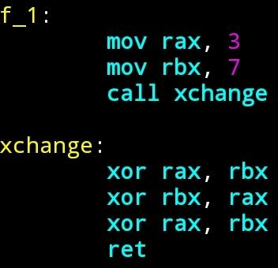
Argument passing
Can be done in many ways, via registers, stack, or both, depends on the convention:
via regs
Note the function xchange here assumes that the caller knows that rbx and rax can both be changed by the function. This is a part of the calling convention!

Slide 49
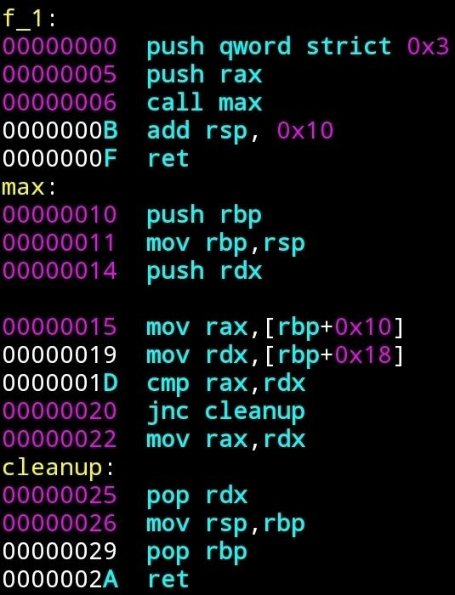
via Stack:

Slide 50
addr
content
1000
????
1008
????
rsp = 0x1040
1010
????
rbp = v
1018
????
rax = r
1020
????
rdx = u
1028
????
1030
????
1038
????
1040
caller_rip

Slide 51
addr
content
1000
????
1008
????
rsp = 0x1038
1010
????
rbp = v
1018
????
rax = r
1020
????
rdx = u
1028
????
1030
????
1038
0x03
1040
caller_rip

Slide 52
addr
content
1000
????
1008
????
rsp = 0x1030
1010
????
rbp = v
1018
????
rax = r
1020
????
rdx = u
1028
????
1030
r
1038
0x03
1040
caller_rip

Slide 53
addr
content
1000
????
1008
????
rsp = 0x1028
1010
????
rbp = v
1018
????
rax = r
1020
????
rdx = u
1028
0x0b
1030
r
1038
0x03
1040
caller_rip

Slide 54
addr
content
1000
????
1008
????
rsp = 0x1020
1010
????
rbp = v
1018
????
rax = r
1020
v
rdx = u
1028
0x0b
1030
r
1038
0x03
1040
caller_rip

Slide 55
addr
content
1000
????
1008
????
rsp = 0x1020
1010
????
rbp = 0x1020
1018
????
rax = r
1020
v
rdx = u
1028
0x0b
1030
r
1038
0x03
1040
caller_rip

Slide 56
addr
content
1000
????
1008
????
rsp = 0x1018
1010
????
rbp = 0x1020
1018
u
rax = r
1020
v
rdx = u
1028
0x0b
1030
r
1038
0x03
1040
caller_rip

Slide 57
addr
content
1000
????
1008
????
rsp = 0x1018
1010
????
rbp = 0x1020
1018
u
rax = r
1020
v
rdx = u
1028
0x0b
1030
r
1038
0x03
1040
caller_rip

Slide 58
addr
content
1000
????
1008
????
rsp = 0x1018
1010
????
rbp = 0x1020
1018
u
rax = r
1020
v
rdx = 0x03
1028
0x0b
1030
r
1038
0x03
1040
caller_rip

Slide 59
addr
content
1000
????
1008
????
rsp = 0x1018
1010
????
rbp = 0x1020
1018
u
rax = r
1020
v
rdx = 0x03
1028
0x0b
1030
r
1038
0x03
1040
caller_rip

Slide 60
addr
content
1000
????
1008
????
rsp = 0x1018
1010
????
rbp = 0x1020
1018
u
rax = r
If r <=3
1020
v
rdx = 0x03
1028
0x0b
1030
r
1038
0x03
1040
caller_rip

Slide 61
addr
content
1000
????
1008
????
rsp = 0x1018
1010
????
rbp = 0x1020
1018
u
rax = max(r,0x03)
1020
v
rdx = 0x03
1028
0x0b
1030
r
1038
0x03
1040
caller_rip

Slide 62
addr
content
1000
????
1008
????
rsp = 0x1020
1010
????
rbp = 0x1020
1018
u
rax = max(r,0x03)
1020
v
rdx = u
1028
0x0b
1030
r
1038
0x03
1040
caller_rip

Slide 63
addr
content
1000
????
1008
????
rsp = 0x1020
1010
????
rbp = 0x1020
1018
u
rax = max(r,0x03)
1020
v
rdx = u
1028
0x0b
1030
r
1038
0x03
1040
caller_rip

Slide 64
addr
content
1000
????
1008
????
rsp = 0x1028
1010
????
rbp = v
1018
u
rax = max(r,0x03)
1020
v
rdx = u
1028
0x0b
1030
r
1038
0x03
1040
caller_rip

Slide 65
addr
content
1000
????
1008
????
rsp = 0x1030
1010
????
rbp = v
1018
u
rax = max(r,0x03)
1020
v
rdx = u
1028
0x0b
1030
r
1038
0x03
1040
caller_rip

Slide 66
addr
content
1000
????
1008
????
rsp = 0x1040
1010
????
rbp = v
1018
u
rax = max(r,0x03)
1020
v
rdx = u
1028
0x0b
1030
r
1038
0x03
1040
caller_rip

Slide 67
Regs and stack
Common, if there are enough registers, use them, the rest goes on the stack.

Slide 68
Local Variables
Some code might require local variables. For example: iteratively use external code.
The solution, use the memory, specifically local variables stored on the stack.
Example: a(n) = a(n-1)+9*(a(n-2)+3) . (a(0)=a(-1)=0).

Slide 69
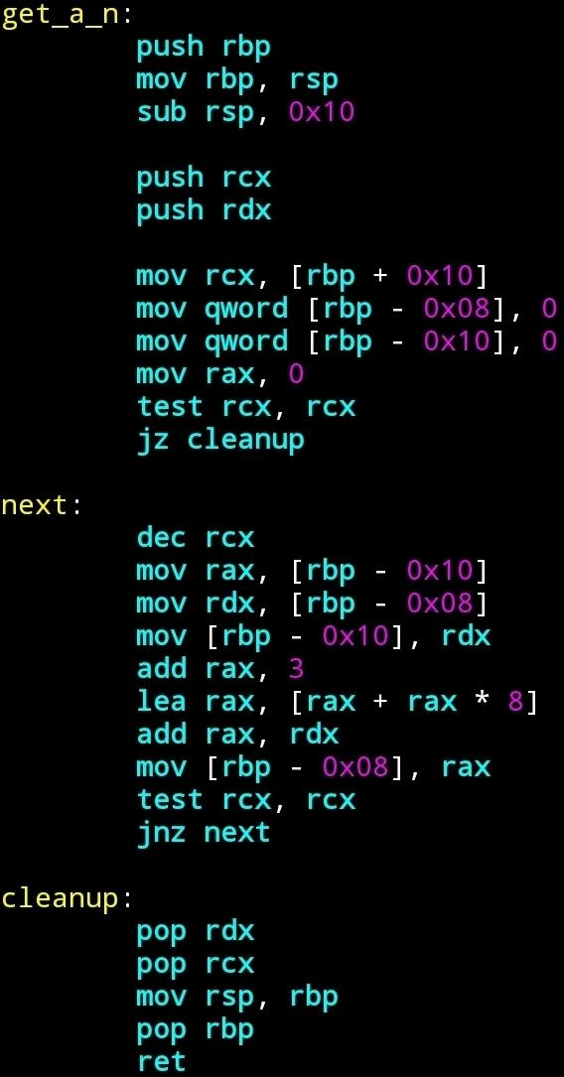
Reserve space for locals
Use locals: rbp - 0x08 is the adderss of a(n-1)
rbp - 0x10 is the address of a(n-2)
????
As rbp stays constant though the function (at any point in the functions code), accessing the locals / args is done via rbp.
(Theoretically anything of fixed offset from the frame)
a_n-2
a_n-1
memory direction
rbp
caller_rbp
caller_rip
arg_0=n

Slide 70
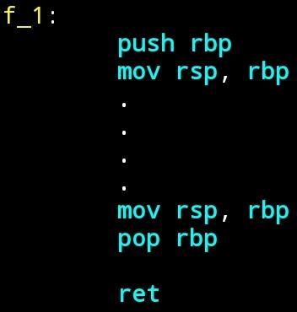
Notes
aka “prologue”
aka “epilogue”
Since stack frames are very common, there exist special instructions “enter” and “leave” that preform the prologue and epilogue respectively “in one instruction”.
They additionally supply even more functionality (allow copying of base pointers of previous stack frames to enable accessing local variables of higher scopes in the call stack).
That is

Slide 71
enter n,0 ⇔ push rbp
(or enter 0 if n=0) mov rbp, rsp
sub rsp, n
leave ⇔ mov rsp, rbp
pop rbp
Note they do not have to be used together (usually push mov and leave are used).

Slide 72
Cleaning the arguments:
In the case where arguments are pushed on the stack, who “cleans them up”?
If the number of arguments is fixed, this could be the callee, and is even supported by the ret instruction:
ret n ⇔ add rsp, (n + 1)*0x08
mov rip, [rsp - (n+1)*0x08]
(“ret” = ret 0)

Slide 73
But there are functions which have a variable number of arguments:
An example is printf(frmt, ….), which prints the variables pushed on the stack, according to the format specified by format.
An example of a usage would be
printf(“%s has %d %cs in it.”, “Alon”, 1, ‘o’);
The format “%s has %d %cs in it.” specifies that the function should assume that there are 3 arguments that were pushed, the first (last in push order) is a pointer to a character arrays (ending with ‘\0’), the second is an integer, the third a character.)
That is, printf cannot know the number of arguments it will get, before the actual call to it.
In cases like this the caller must be responsible for retuning rsp to its value before the pushing of the arguments:

Slide 74
Summing it all up:
A calling conventions is a set of rules which allows functions to talk to each other.
It specifies how parameters are passed to a callee, which registers should be preserved and in what state should the stack be returned to the caller.
x86-64 common calling conventions:
Microsoft x64 Calling convention (https://docs.microsoft.com/en-us/cpp/build/x64-calling-convention?view=msvc-170).
System V AMD64 ABI (https://github.com/hjl-tools/x86-psABI/wiki/x86-64-psABI-1.0.pdf)
see also https://en.m.wikipedia.org/wiki/X86_calling_conventions

Slide 75
Summary of calling conventions¹:
MS x64 AMD64
param: RCX, RDX, R8, R9 RDI, RSI, RDX,
and stack RCX, R8, R9 and
stack
non volatile regs - RBX, RBP, RDI, RSI, RBX, RSP, RBP,
- (callee saved): RSP, R12-R15 R12–R15
stack alignment: 16 bytes 16 bytes
arg cleanup: caller caller
1 see also https://en.m.wikipedia.org/wiki/X86_calling_conventions

Slide 76
Enjoyed? Probably not….

Slide 77
C
A Low Level programming language.
Provides abstraction over the machine.
Expressive enough to enable very common programming concepts and ideas.¹
Spares us dealing with things we do not want to deal with (which are technical and can be done ‘automatically’), while preserving most of the power in manipulating memory and data.
Enables much more friendly usage of the machine.
1 Zhirkov, Low-Level Programming

Slide 78
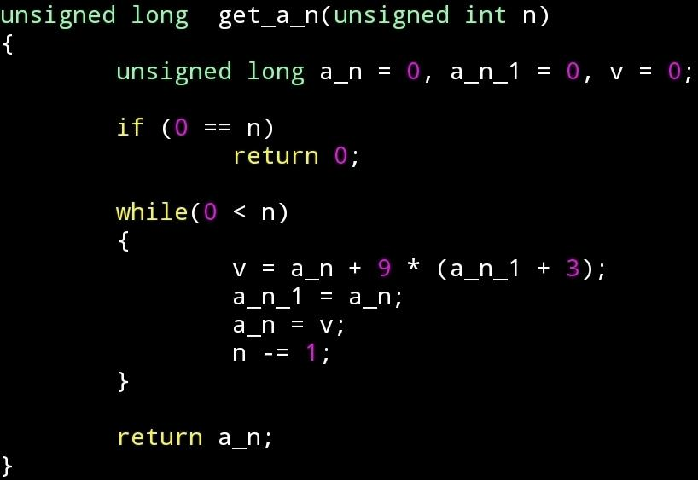
vs

Slide 79
The process of producing machine code from c (compiling c) is more complex than producing machine code from assembly (compiling/assembling assembly), as it is in less correspondance with machine code.
There are many more programming languages which compile to (“native”) machine code (e.g. cpp, rust, go, pascal).
They usually offer different abstraction capabilities designed for different puposes.

Slide 80
Process Overview
file formats, loading, memory, runtime and
standard library, heap

Slide 81
Program loading and file formats
In last weeks exercise you assembled your assembly code into machine code, stored it in a file, and used our code to call it.
Our code knew to take the data that is given in the file you supplied it, load it into the memory, and “run it”.
The code you supplied was rather simple, in the sense that it essentially did nothing and interacted with no other pieces of code.
In normal use cases, we would like to be able to interact with other code and preform complex functionality:
Often we would like to use shared code that already exists, and have different resources available to us when we are running.
Maybe we even want to write code so that other programs could use it.

Slide 82
Usually, the operating system is responsible for loading code of applications, supplying it with resources it would often require and running it.
This is part of the funcitonality of the operating system is the part we will be interested in in this lecture.

Slide 83
(Binary) File Formats
As we’ve mentioned the operating system should be able to load a program along with external code, that it wants to use.
That means the os needs to:
have a way to know that a piece of code, wants to use another piece of code.
have a way to know how a piece of code, can be used by another piece of code.
Somehow make all the pieces of code run together even though they were compiled separately and exist in different files.
All this meta data managment and code integration is done by having code compiled to a specific file format with which the OS knows how to work.
These are sometimes referred to as “modules” or “object files”.
In linux type systems, this format is called ELF (in windows these are exes and dlls, in osx these are dylibs)

Slide 84
ELF - Executable and Linkable Format
When compiling code for linux systems, the code is compiled to a binary format called ELF.
An ELF file can be of 1 of 3 subtypes:
Relocatable object file, usually suffixed by “.o”
Executable object file, usually suffixed by nothing.
Shared object files, usually suffixed by “.so”
The formats of the different subtypes are very similar, each usually containing a bit of extra data specific to the use of the type of file.
To understand the usage, we recall the compilation process.

Slide 85
(A very general) Overview of the compilation process
file_1.c file_2.asm file_3.cpp
compile
(cc -c)
assemble
(nasm -f elf64)
compile
(cpp -c)
file_1.o file_2.o file_3.o
link
(ld)
link
(ld -shared)
program_12
lib23.so

Slide 86
Relocatable object files - .o
These are object files which are the default output format of the compiler.
They contain the code compiled from a source file, and meta data that can be used to merge this code, in a process called linking, with other object files.
They are intended to be used statically, meaning that code that wants to use code these object files can reference data and code in them and ask to be linked with them, and the (static) linker will merge the files into a single file (and preform symbol resolving and fixups which we will expand on later) so that they can use each others code.
Also several such object files can be merged to an “archive” static library (.a) which can be used to link with in the same way).

Slide 87
Executable object files
These are object files which are the default output format of the linker.
They contain the code compiled and linked from one or more source files, and meta data that can be used to run this program as the “main code” (image) of a program.
They can be created by linking several relocatable object files.
They also contain information used to load and reference code and data which they want to use, and is not compiled with them (from shared object files, the following).

Slide 88
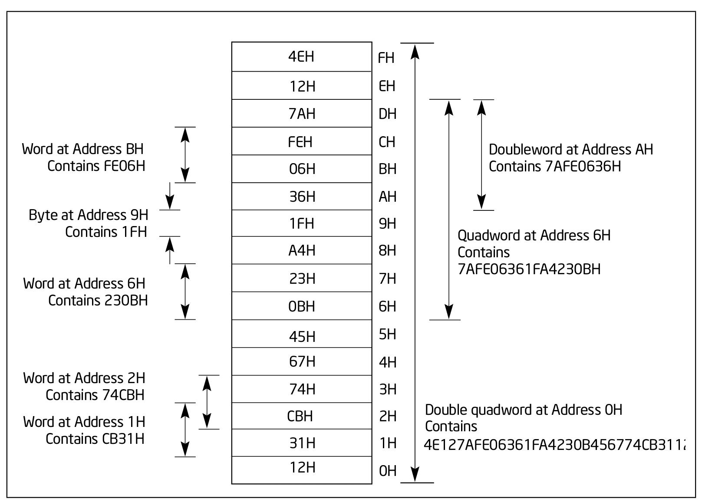
More examples from intel manual:
https://www.intel.com/content/www/us/en/develop/download/intel-64-and-ia-32-architectures-software-developers-manual-volume-1-basic-architecture.html

Slide 89
Registers
Some are “general purpose”, some have some “specific purpose”.
In practice, most registers can be manipulated similarly using the same instructions.
Reason of specific purpose:
some features are common in most programs, and so it is convenient to have special registers and instructions: for example stack pointers (rsp, rbp) which can used to maintain a stack in the memory, and serve as pointers for the “push” and “pop” instructions.
Special instructions can be encoded in less bytes: the “push” instruction always stores a value at the address given in rsp, that is
instruction: push eax sub rsp, 8
mov [rsp], eax
encoding: 50 48 83 ec 08
48 89 04 24

Slide 90
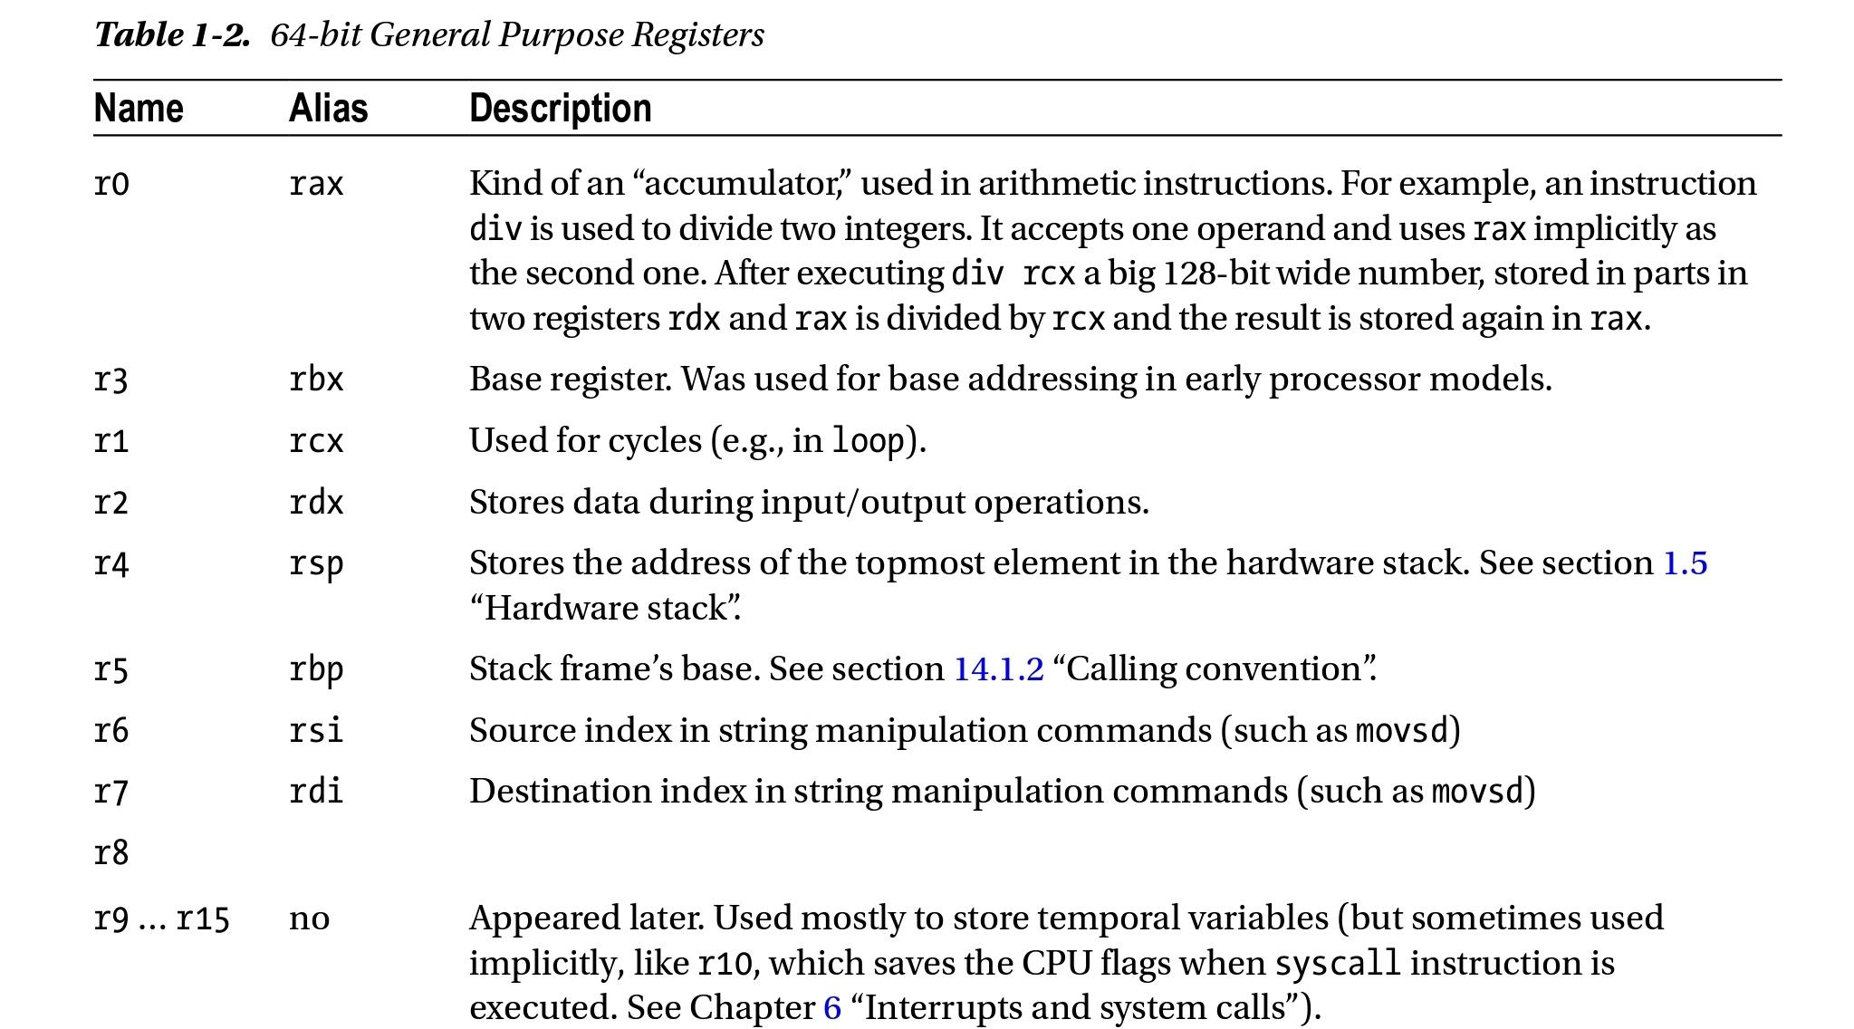
From: Low Level Programming C, Assembly and Program Execution on Intel 64 Architecture

Slide 91
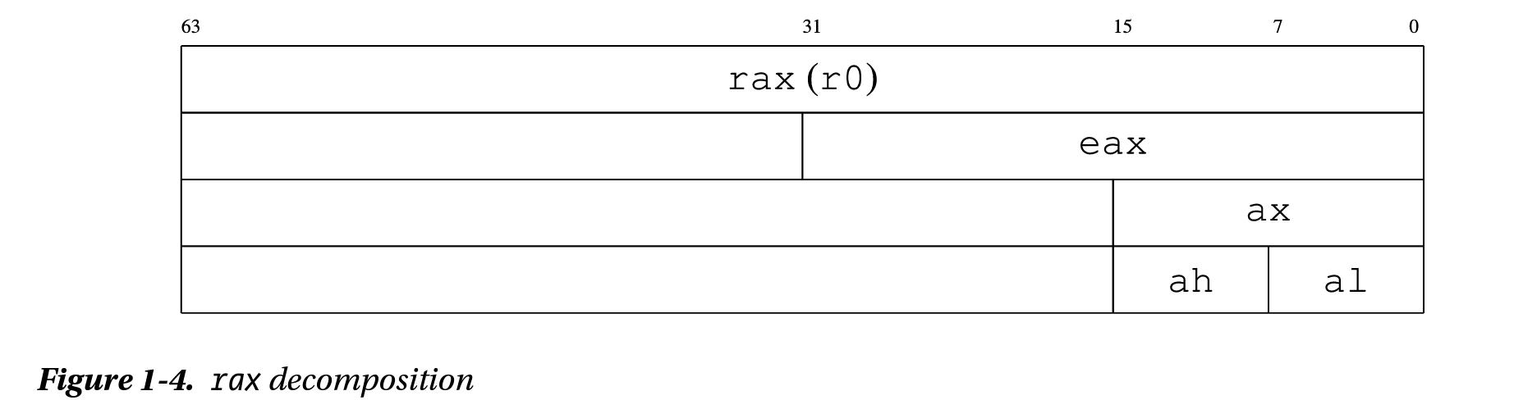
General purpose registers (GPRs)
Used as general operands in different instructions.
Some can have only a specific part of them as an operand.
Depends on the register and the instruction.

Slide 92
Special registers
rip and rflags registers.
Segment registers (CS, DS, SS, ES, FS, and GS).
x87 FPU registers (ST0 through ST7, status word, control word, tag word, data operand pointer, and instruction pointer).
MMX registers (MM0 through MM7).
XMM registers (XMM0 through XMM15) and the MXCSR register.
Control registers (CR0, CR2, CR3, CR4, and CR8) and system table pointer registers (GDTR, LDTR, IDTR, and task register)
Debug registers (DR0, DR1, DR2, DR3, DR6, and DR7).
MSR registers.
The registers used for basic program execution are the general purpose, rip and rflags (in unprivliged code).

Slide 93
rip (the register)
rip contains the address in the memory of the next instruction to be executed.
At each execution “step”, the instruction pointed to by rip will be executed, and rip will be incremented to rip + size in bytes of the executed instruction, so to point to the next instruction.
Note that different instructions are encoded with different lengths, and in fact this execution “step” is divided into suboperations of fetching the instruction at rip, decoding it and the operands from it, and then executing it. This operation is sometimes called “the fetch execute cycle”. We will talk about this later in the course.

Slide 94
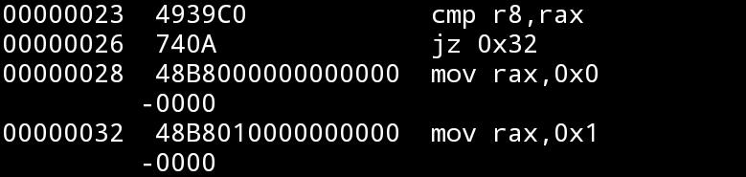
rflags
Contains flags which are updated by some instructions and could be used for conditional execution.
The result of executing the instruction at 26 (after executing the one at 23):
If rax=r8, rip will be set to 32, otherwise it will be set to 28
The lower 32 bits are referred to as “eflags”, the flags register in the x86 arch and have the same format, the upper 32 bits are not used (“reserved”).

Slide 95
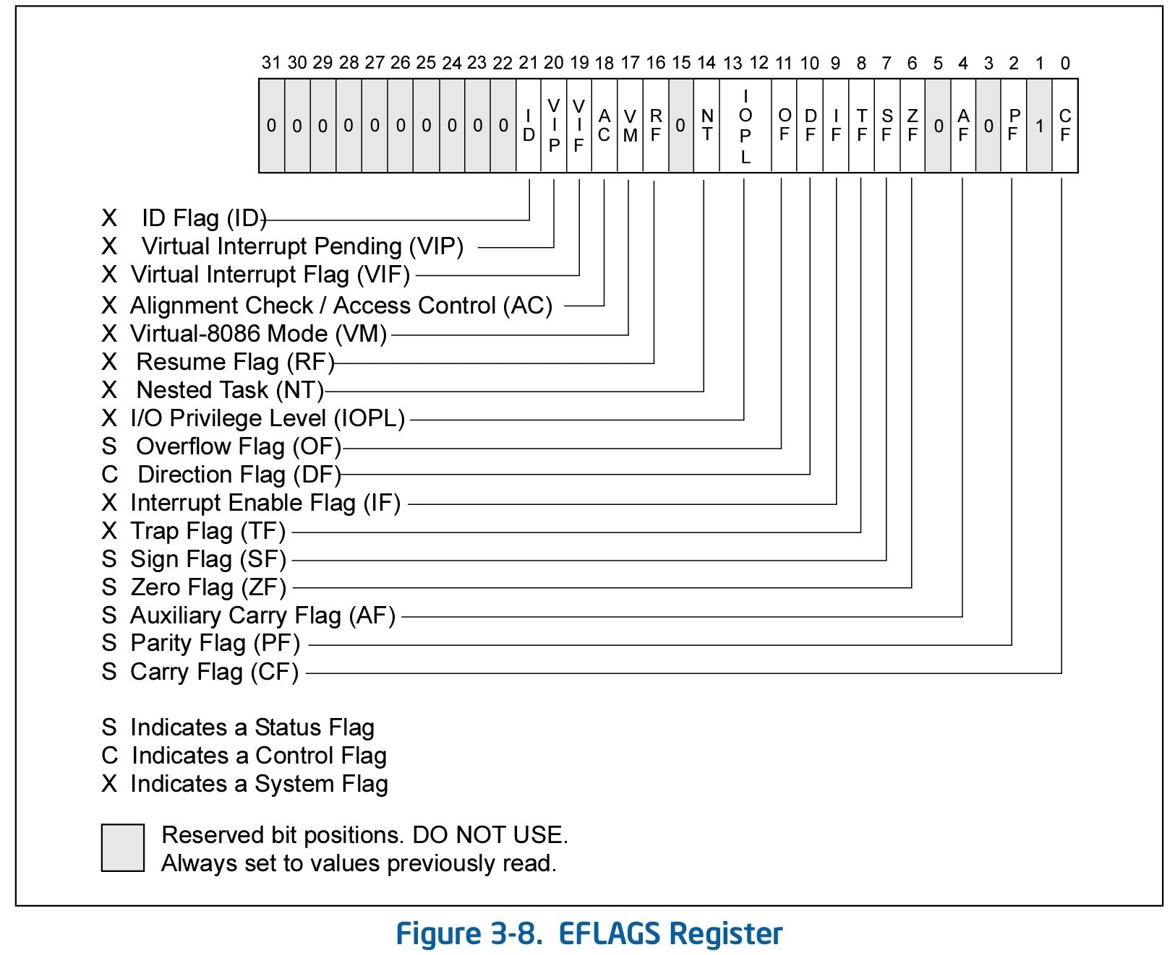

Slide 96
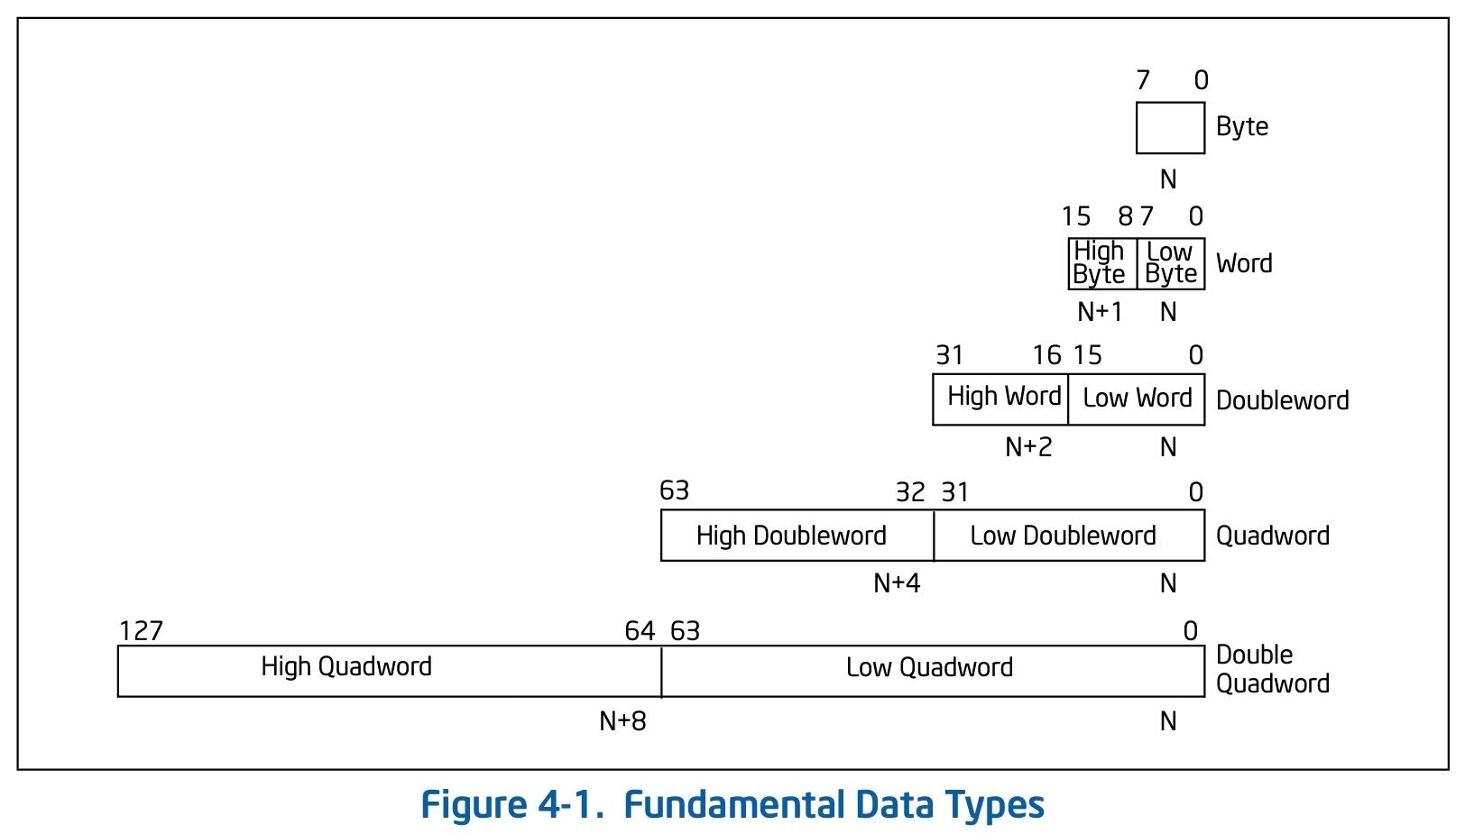
Instructions (preface)
Data types: We have mentioned bytes, words, etc.
A summed up notation table:
(from the Intel reference manual).
N marks the address in the memory.

Slide 97
Instruction operands
An instruction is an operation that operates on some operand.
Different types are possible, depending on the instruction.
There are 3 common operand types (“addressing mode” of data):
Immediate operand:
Some instructions can have data encoded in the instruction itself as a source operand. These operands are called immediate operands (or simply immediates). For example:
mov rax, 0x3a4b is encoded as:
48 b8 4b 3a 00 00 00 00 00 00

Slide 98
Register operand:
Different registers can be source and destination operands for different instructions (depending on the instructions and the operands).
For example:
mov rax, rbx
push rcx
add rdx, 3.
Memory operands
segment selector + offset.
Usually (for code running in the same privilige in modern pcs) this is virtually not used (constant), and so we do not expand on this.
We will (possibly) talk about segment selectors later in the course.
Example of memory addressing instructions:
mov rax, [rdx]; // move into rax, the (qword) value stored in the memory location rdx
mov word [rbx + 8], 0x0009; // move into the word at memory location rbx+8, the value 0x0009

Slide 99
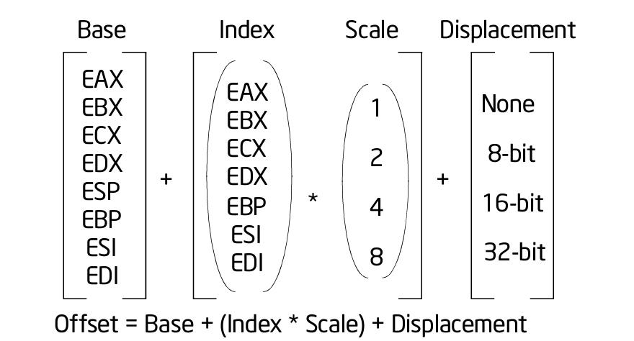
Addressing modes (i.e. format of ‘offset’, in 32 bit):
64 bit: Displacement: 8/16/32 bit value, Base: Value of a 64 bit GPR, Index: Value of a 64 bit GPR, Scale: 2/4/8 multiplied by index.
Another special supported addressing mode is the value of rip of next instruction + displacement

Slide 100
Note:
Some instructions have implicit register operands (for example cmp updates the flags, and mul has one operand, and always multiplies rax by this operand and stores the 128 bit integer result in rdx and rax where the high word is stored in rdx).
Most instructions have implicit segment register operands (which again are constant and disregarded by us for now).
Some (for example pop) affect several registers / operands implicitely.

Slide 101
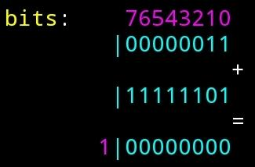
Signs
We wish to be able to preform signed operations.
The way that a signed integer is represented in the memory, is via the 2-complement notation, which uses the fact that unsigned calculations are preformed mod 2^{x} where x is the bitwidth of the integer.
An example of a calculation:
3 as a 1 byte (8 bit) signed integer: 0x03
-3 as a 1 byte (8 bit) signed integer: 0xFD
When we add them up and store
the result as a 1 byte integer:
3+(-3) = 0x03 + 0xFD =
The resulting carry bit is dropped, as we are storing the result in an 8 bit integer, that is we get (0x03+0xfd)% 2⁸ = 0.

Slide 102
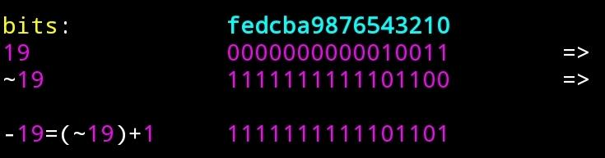
The binary representation of the number x as an log(x)+1 bit integer is therefore:
-x = (~x)+1, where ~x (not x) is the number which in binary representation has 1 in bit j iff x has 0 in bit j.
That is, to get the binary representation of -x, we “flip” all of the bits in the binary representation of x, and add 1.
example -19 as a 4 byte integer:
19 as a 2 byte integer is given by 1*2⁰+1*2¹+0*2²+0*2³+1*2⁴+0*2⁵+0*.... =>

Slide 103
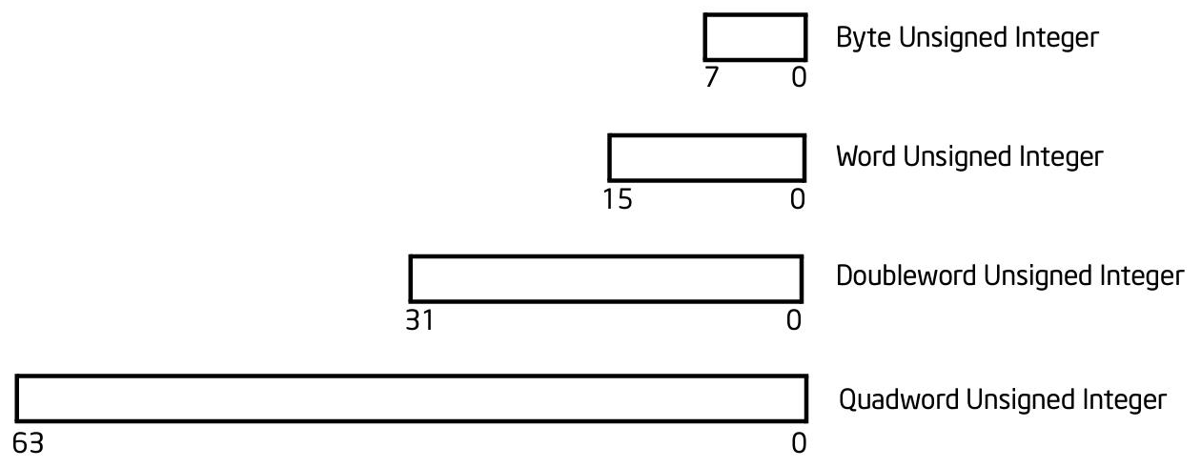
“Negative” numbers under this representation are considered the numbers with 1 at the most segnificant bit.
Notice that under this representation for a signed integer, we get that with k bytes (8k bits) we can represent the integers x where:
-2^{8k-1}<=x<=2^{8k-1}-1 (a total of 2^{8k-1}+1+2^{8k-1}-1=2^{8k} integers).
To summarize:
Unsigned integers:

Slide 104
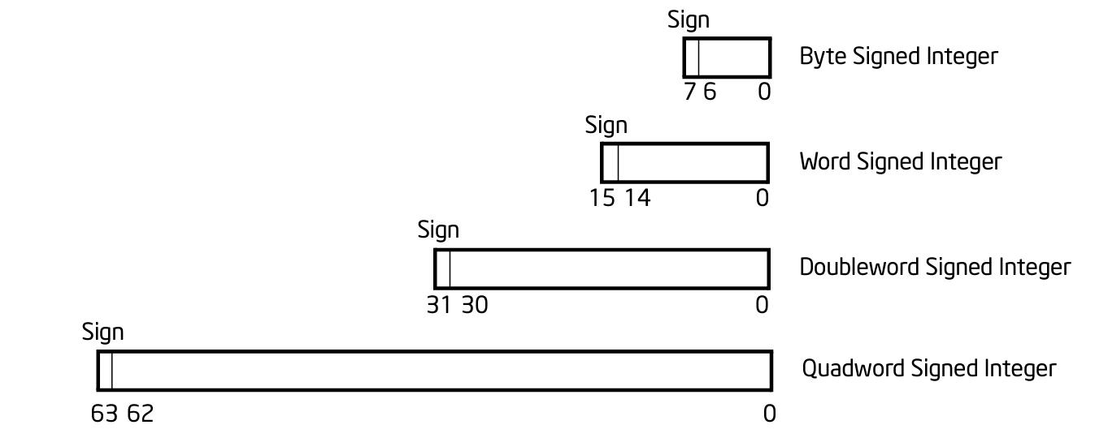
Signed integers:

Slide 105
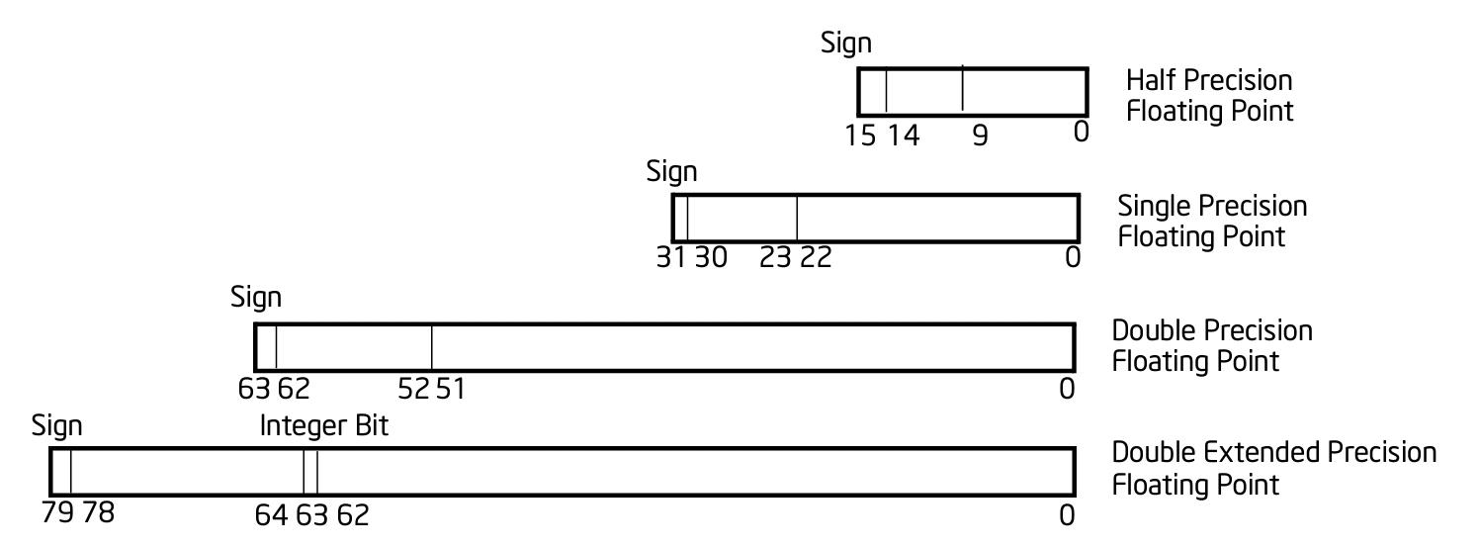
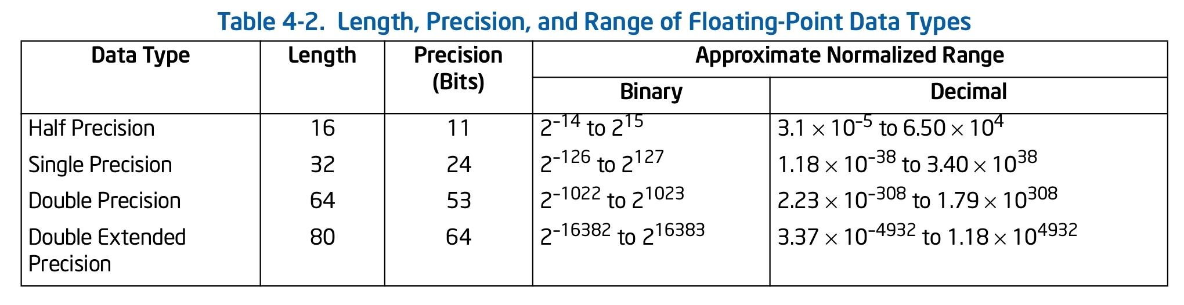
Floating point operands (less important to us)

Slide 106
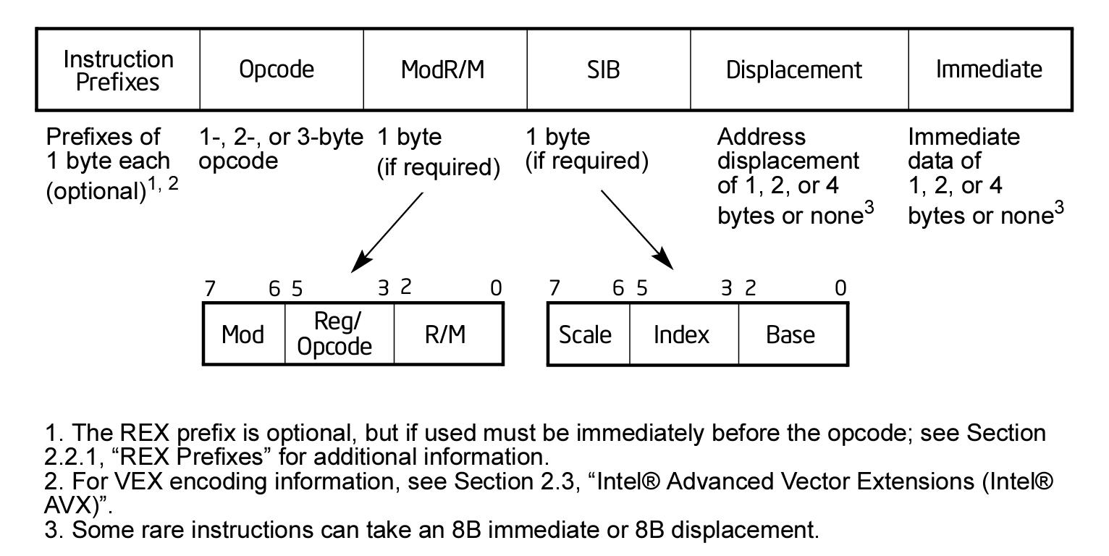
Finally, instructions
x86(-64) instruction encoding:

Slide 107
Instruction types:
• Basic instructions - mov, jmp
• Stack - push, pop
• ALU - add, mul, xor
• Floating point - faddp, fdiv
• SIMD (single instruction, multiple data)
• MMX, SSE*
• String Operations
• Protection modes, interrupts, many more…
Instruction structure:
INSTR [operand_0, operand_1, ….]
Note: Many instructions affect the flags register implicitly.

Slide 108
Common types of instructions
Arithmetic Instructions:
add / sub
inc / dec
mul / div / imul / idiv
and / or / xor / not
shl / shr (shift left / right)
cmp / test (affect the flags like sub / and, but do not alter the other operand values)
Load / Store Instructions:
mov
lea
push / pop
pusha(d) / popa(d)

Slide 109
Control flow (related) Instructions:
call
ret
enter / leave
jmp
j(z/e/nz/ne)
j(b/a/be/ae) (unsigned)
j(g/l/ge/le) (signed)
Misc instructions:
nop
sysenter / sysexit / syscall / sysret
cpuid, clflush
Privileged (lgdt, lidt, cli ….)

Slide 110
References (Many of the figures are taken from here):
Architecture:
https://www.intel.com/content/www/us/en/architecture-and-technology/64-ia-32-architectures-software-developer-vol-1-manual.html
Instruction set:
https://www.intel.com/content/dam/www/public/us/en/documents/manuals/64-ia-32-architectures-software-developer-instruction-set-reference-manual-325383.pdf

Slide 111
Code: examples and tips

Slide 112
REMOVE THIS IS STUPID
In addition, we would usually want to be able to run our code in a “bigger system”, (“host” / “operating system”):
Most programs we know use similar facilities and functionality for basic tasks, and it makes sense that they all use some common infrastructure, and not implement it each on it’s own.
This is essentially offered by the operating system.
We will go into detail on differents aspects of the operating system later, but now want to focus on the following task which the operating system wants to be able to do:

Slide 113
THIS ALSO
Enable running different “programs” / ”applications” (logical independent units of code that preform something) on the same machine.
From this we get sub tasks that we want to preform as an operating system:
Enable storing of data on our machine, in particular store the code of programs and support running them when asked to.
Supply the programs we run with basic resources and capabilities they would possibly need to use. In particular other common code that they would want to use.
Enable different programs to use each others functionality, and to communicate with each other.

